Slide 1
Module 3

Slide 2
Module 3
Signal Encoding techniques - Digital Data Digital Signals: NRZ, Multilevel binary, Biphase - Digital Data Analog Signals : ASK, FSK, PSK - Analog Data Digital Signals: Sampling theorem, PCM, Delta Modulation - Analog Data Analog Signals: AM, FM, PM

Slide 3
DIGITAL~TO~DIGITAL CONVERSION

Slide 4
DIGITAL~TO~DIGITAL CONVERSION
We said that data can be either digital or analog
we see how we can represent digital data by using digital signals.
The conversion involves three techniques:
  line coding,
  block coding,
  scrambling.

Slide 5
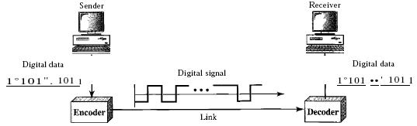
Line Coding
Line coding is the process of converting digital data to digital signals.
We assume that data, in the form of text, numbers, graphical images, audio, or video, are stored in computer memory as sequences of bits.
Line coding converts a sequence of bits to a digital signal.
At the sender, digital data are encoded into a digital signal; at the receiver, the digital data are recreated by decoding the digital signal.

Slide 6
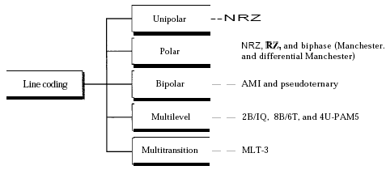
Line Coding Schemes

Slide 7

Unipolar Scheme
In a unipolar scheme, all the signal levels are on one side of the time axis, either above or below.
NRZ (Non-Return-to-Zero)
  Traditionally, a unipolar scheme was designed as a non-return-to-zero (NRZ) scheme in which the positive voltage defines bit 1 and the zero voltage defines bit 0.
  It is called NRZ because the signal does not return to zero at the middle of the bit.

Slide 8
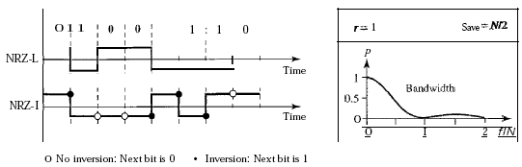
Polar Schemes
In polar schemes, the voltages are on the both sides of the time axis.
For example, the voltage level for 0 can be positive and the voltage level for 1 can be negative.
In NRZ-L the level of the voltage determines the value of the bit. In NRZ-I the inversion or if there is no change, the bit is 0; if there is a change, the bit is 1.
.

Slide 9
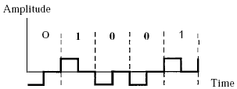
Return to Zero (RZ)
The main problem with NRZ encoding occurs when the sender and receiver clocks are not synchronized. The receiver does not know when one bit has ended and the next bit is starting.
One solution is the return-to-zero (RZ) scheme, which uses three values: positive, negative, and zero. In RZ, the signal changes not between bits but during the bit.
Here the signal goes to 0 in the middle of each bit. It remains there until the beginning of the next bit. The main disadvantage of RZ encoding is that it requires two signal changes to encode a bit and therefore occupies greater bandwidth.

Slide 10
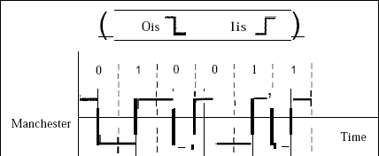
Biphase
Manchester
The idea of RZ (transition at the middle of the bit) and the idea of NRZ-L are combined into the Manchester scheme.
In Manchester encoding, the duration of the bit is divided into two halves. The voltage remains at one level during the first half and moves to the other level in the second half. The transition at the middle of the bit provides synchronization.

Slide 11
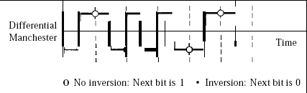
Differential Manchester
It combines the ideas of RZ and NRZ-I. There is always a transition at the middle of the bit, but the bit values are determined at the beginning of the bit. If the next bit is 0, there is a transition; if the next bit is 1, there is none.

Slide 12
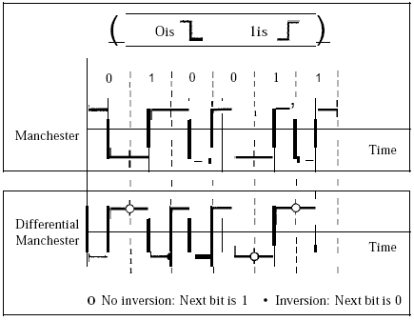
Polar biphase: Manchester and differential Manchester schemes
Here the transition at the middle of the bit is used for synchronization

Slide 13
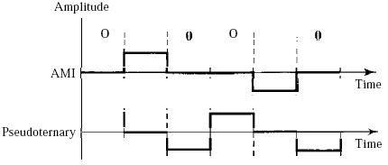
Bipolar Schemes
In bipolar encoding (sometimes called multilevel binary), there are three voltage levels: positive, negative, and zero.
The voltage level for one data element is at zero, while the voltage level for the other element alternates between positive and negative.

Slide 14
variations of bipolar encoding:
AMI and pseudoternary.
A common bipolar encoding scheme is called bipolar alternate mark inversion (AMI). In the term alternate mark inversion, the word mark comes from telegraphy and means 1.
So AMI means alternate 1 inversion. A neutral zero voltage represents binary O. Binary 1s are represented by alternating positive and negative voltages.
A variation of AMI encoding is called pseudoternary in which the 1 bit is encoded as a zero voltage and the 0 bit is encoded as alternating positive and negative voltages.

Slide 15
Key Techniques - ASK, FSK, PSK, DPSK

Slide 16
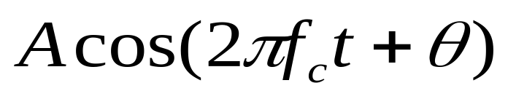
Digital Data to Analog Signal
Main use is public telephone system
  has freq range of 300Hz to 3400Hz
  use modem (modulator-demodulator)
The digital data modulates the amplitude A, frequency f_{c} , or phase θ of a carrier signal
Modulation techniques
  Amplitude Shift Keying (ASK)
  Frequency Shift Keying (FSK)
  Phase Shift Keying (PSK)
Notes:
We turn now to the case of transmitting digital data using analog signals. The most familiar use of this transformation is for transmitting digital data through the public telephone network. The telephone network was designed to receive, switch, and transmit analog signals in the voice-frequency range of about 300 to 3400 Hz. It is not at present suitable for handling digital signals from the subscriber locations (although this is beginning to change). Thus digital devices are attached to the network via a modem (modulator-demodulator), which converts digital data to analog signals, and vice versa.
Have stated that modulation involves operation on one or more of the three characteristics of a carrier signal: amplitude, frequency, and phase. Accordingly, there are three basic encoding or modulation techniques for transforming digital data into analog signals, as illustrated in Stallings DCC8e Figure 5.7 (next slide): amplitude shift keying (ASK), frequency shift keying (FSK), and phase shift keying (PSK). In all these cases, the resulting signal occupies a bandwidth centered on the carrier frequency.

Slide 17
Modulation Techniques
Amplitude shift keying (ASK) A modulation method in which the amplitude of the carrier signal is varied to represent binary 0 or 1.
Frequency shift keying (FSK) A digital-to-analog encoding method in which the frequency of the carrier signal is varied to represent binary 0 or 1.
phase shift keying (PSK) A digital-to-analog modulation method in which the phase of the carrier signal is varied to represent a specific bit pattern.

Slide 18
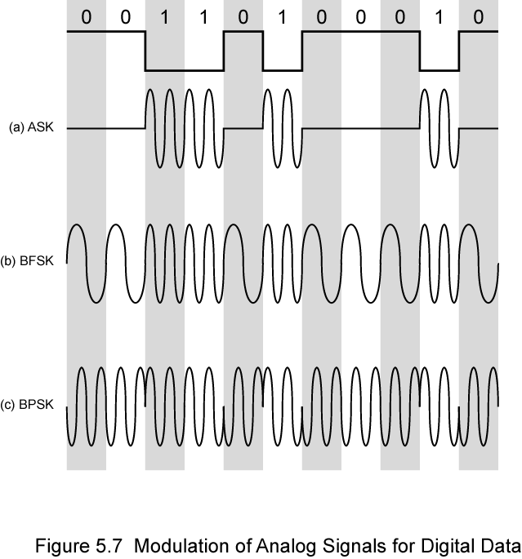
Modulation Techniques
Amplitude Shift Keying (ASK)
Binary Frequency Shift Keying (BFSK)
Binary Phase Shift Keying (BPSK)
Notes:
Have stated that modulation involves operation on one or more of the three characteristics of a carrier signal: amplitude, frequency, and phase. Accordingly, there are three basic encoding or modulation techniques for transforming digital data into analog signals, as illustrated in Stallings DCC8e Figure 5.7 (above): amplitude shift keying (ASK), frequency shift keying (FSK), and phase shift keying (PSK). In all these cases, the resulting signal occupies a bandwidth centered on the carrier frequency.

Slide 19
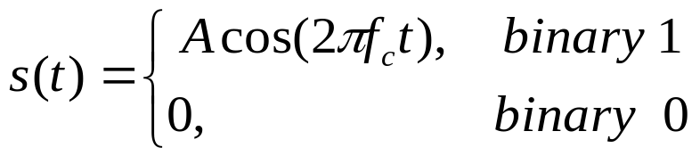
Amplitude Shift Keying (ASK)
In ASK, the two binary values are represented by to different amplitudes of the carrier frequency
The resulting modulated signal for one bit time is
Susceptible to noise
Inefficient modulation technique
used for
  up to 1200bps on voice grade lines
  very high speeds over optical fiber
Notes:
In ASK, the two binary values are represented by two different amplitudes of the carrier frequency. Commonly, one of the amplitudes is zero; that is, one binary digit is represented by the presence, at constant amplitude, of the carrier, the other by the absence of the carrier, as shown in Stallings DCC8e Figure 5.7a.
ASK is susceptible to sudden gain changes and is a rather inefficient modulation technique. On voice-grade lines, it is typically used only up to 1200 bps.
The ASK technique is used to transmit digital data over optical fiber, where one signal element is represented by a light pulse while the other signal element is represented by the absence of light.

Slide 20
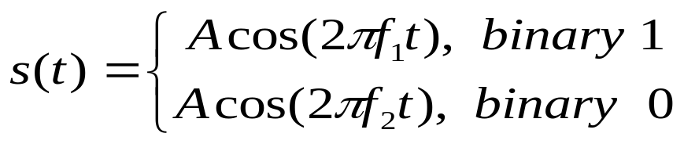
Binary Frequency Shift Keying (BFSK)
The most common form of FSK is Binary FSK (BFSK)
Two binary values represented by two different frequencies ( f₁ and f₂ )
less susceptible to noise than ASK
used for
  up to 1200bps on voice grade lines
  high frequency radio (3 to 30MHz)
  even higher frequency on LANs using coaxial cable
0 | 0 | 1 | 1 | 0 | 1 | 0 | 0 | 0 | 1 | 0
f₂ | f₂ | f₁ | f₁ | f₂ | f₁ | f₂ | f₂ | f₂ | f₁ | f₂
Notes:
The most common form of FSK is binary FSK (BFSK), in which the two binary values are represented by two different frequencies near the carrier frequency, as shown in Stallings DCC8e Figure 5.7b.
BFSK is less susceptible to error than ASK. On voice-grade lines, it is typically used up to 1200 bps. It is also commonly used for high-frequency (3 to 30 MHz) radio transmission. It can also be used at even higher frequencies on local area networks that use coaxial cable.

Slide 21
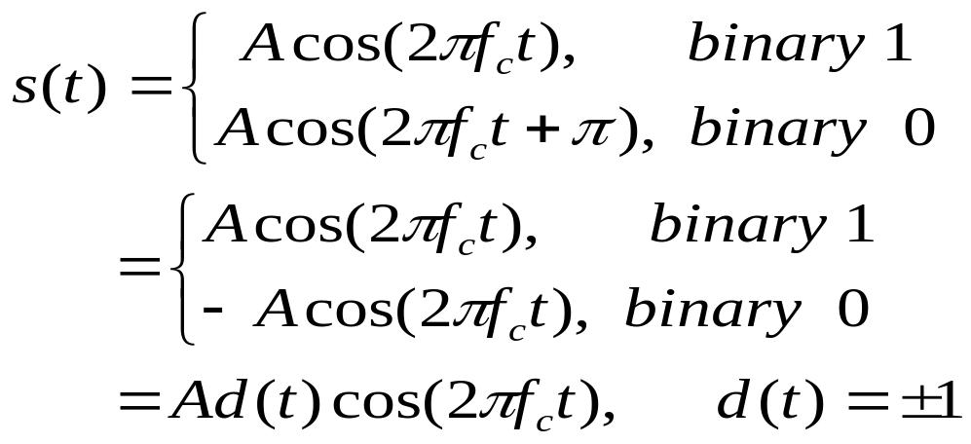
Phase Shift Keying (PSK)
Phase of carrier signal is shifted to represent data
Binary PSK (BPSK): two phases represent two binary digits
0 | 0 | 1 | 1 | 0 | 1 | 0 | 0 | 0 | 1 | 0
π | π | 0 | 0 | π | 0 | π | π | π | 0 | π
Notes:
In PSK, the phase of the carrier signal is shifted to represent data. The simplest scheme uses two phases to represent the two binary digits (Figure 5.7c) and is known as binary phase shift keying.
An alternative form of two-level PSK is differential PSK (DPSK). In this scheme, a binary 0 is represented by sending a signal burst of the same phase as the previous signal burst sent. A binary 1 is represented by sending a signal burst of opposite phase to the preceding one. This term differential refers to the fact that the phase shift is with reference to the previous bit transmitted rather than to some constant reference signal. In differential encoding, the information to be transmitted is represented in terms of the changes between successive data symbols rather than the signal elements themselves. DPSK avoids the requirement for an accurate local oscillator phase at the receiver that is matched with the transmitter. As long as the preceding phase is received correctly, the phase reference is accurate.

Slide 22
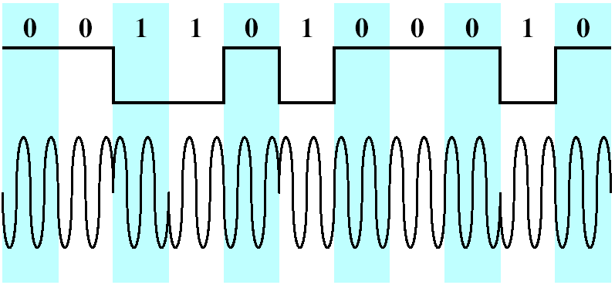
Differential PSK (DPSK)
In DPSK, the phase shift is with reference to the previous bit transmitted rather than to some constant reference signal
Binary 0:signal burst with the same phase as the previous one
Binary 1:signal burst of opposite phase to the preceding one

Slide 23
ANALOG-TO-DIGITAL CONVERSION
Sometimes, however, we have an analog signal such as one created by a microphone or camera.
A digital signal is superior to an analog signal.
The tendency today is to change an analog signal to digital data.
For this we describe two techniques,
  pulse code modulation
  delta modulation.

Slide 24
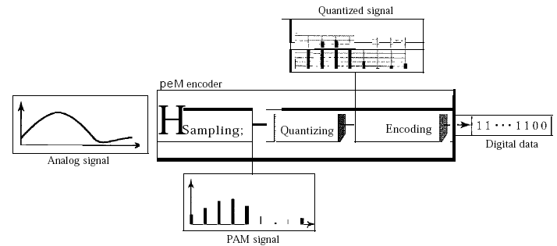
Pulse Code Modulation (PCM)
The most common technique to change an analog signal to digital data (digitization) is called pulse code modulation (PCM).

Slide 25
1. The analog signal is sampled.
2. The sampled signal is quantized.
3. The quantized values are encoded as streams of bits.

Slide 26
Sampling
The process of measuring the instantaneous values of continuous-time signal in a discrete form.
” Sample is a piece of data taken from the whole data which is continuous in the time domain.

Slide 27
Quantization.
The digitization of analog signals involves the rounding off of the values which are approximately equal to the analog values.
The method of sampling chooses a few points on the analog signal and then these points are joined to round off the value to a near stabilized value.
Such a process is called as Quantization.

Slide 28
Encoding
encoding means to convert body of information from one system to another system in the form of codes.

Slide 29
Sampling
The first step in PCM is sampling.
The analog signal is sampled every Ts s, where Ts is the sample interval or period.
The inverse of the sampling interval is called the sampling rate or sampling frequency and denoted by “fs”.
There are three sampling methods-ideal, natural, and flat-top

Slide 30
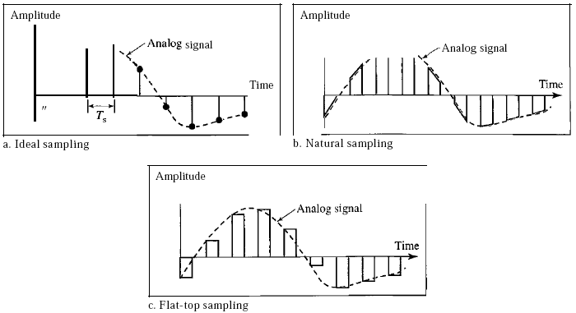
Three different sampling methods for PCM

Slide 31
Three different sampling methods for PCM
In ideal sampling, pulses from the analog signal are sampled. This is an ideal sampling method and cannot be easily implemented.
In natural sampling, a high-speed switch is turned on for only the small period of time when the sampling occurs.
The result is a sequence of samples that retains the shape of the analog signal.
The most common sampling method, called sample and hold, however, creates flat-top samples by using a circuit
According to the Nyquist theorem, to reproduce the original analog signal, one necessary condition is that the sampling rate be at least twice the highest frequency in the original signal.

Slide 32
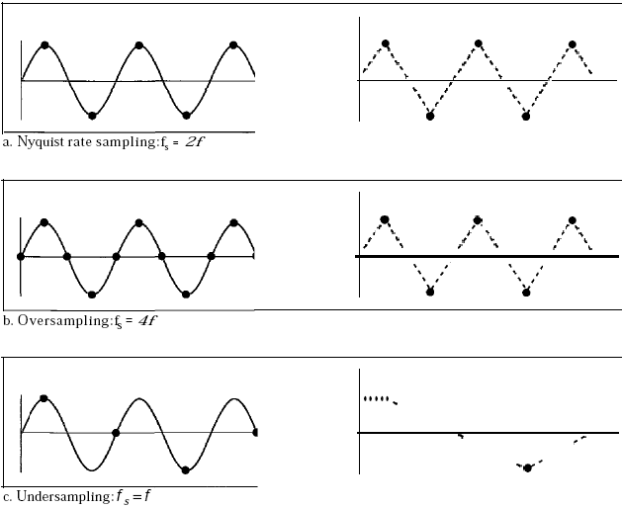
let us sample a simple sine wave at three sampling rates: fs = 4f (2 times the Nyquist rate ) fs = 2f (Nyquist rate) f s =f (one-half the Nyquist rate).
Recovery of a sampled sine wave for different sampling rates

Slide 33
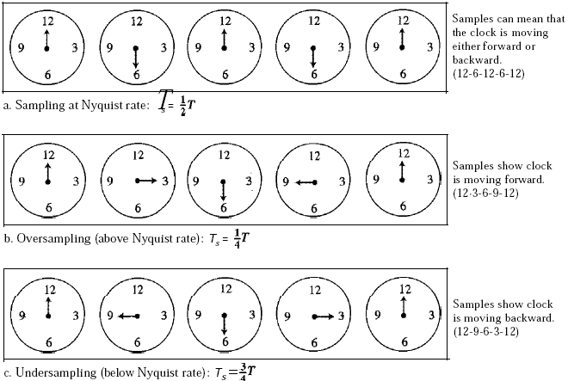
Sampling of a clock with only one hand
the clock is moving forward, but the receiver thinks that the clock is moving backward.

Slide 34
Quantization
The result of sampling is a series of pulses with amplitude values between the maximum and minimum amplitudes of the signal.
The set of amplitudes can be infinite with nonintegral values between the two limits.
These values cannot be used in the encoding process.
The following are the steps in quantization:
1. We assume that the original analog signal has instantaneous amplitudes between Vmin and Vmax'
2. We divide the range into L zones, each of height ∆(delta).
∆ =(Vmax – Vmin) / L
3. We assign quantized values of 0 to L - I to the midpoint of each zone.
4. We approximate the value of the sample amplitude to the quantized values.

Slide 35
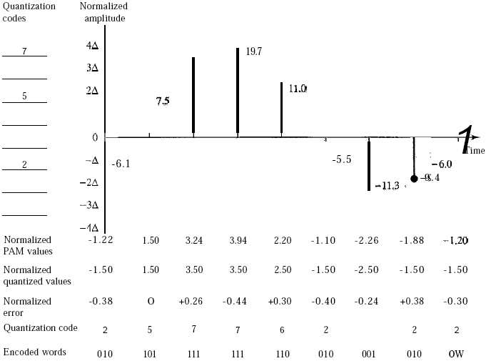
Quantization and encoding of a sampled signal
assume that we have a sampled signal and the sample amplitudes are between -20 and +20 V. We decide to have eight levels (L = 8). This means that ∆ =5 V.
16

Slide 36
16

Slide 37
Quantization and encoding of a sampled signal
We have shown only nine samples using ideal sampling (for simplicity).
The value at the top of each sample in the graph shows the actual amplitude.
In the chart, the first row is the normalized value for each sample (actual amplitude/ ∆).
The quantization process selects the quantization value from the middle of each zone.
This means that the normalized quantized values (second row) are different from the normalized amplitudes.
The difference is called the normalized error (third row).
The fourth row is the quantization code for each sample based on the quantization levels at the left of the graph.
The encoded words (fifth row) are the final products of the conversion.

Slide 38
Quantization Levels
In the previous example, we showed 8 quantization levels.
The choice of L, the number of levels, depends on the range of the amplitudes of the analog signal and how accurately we need to recover the signal.
If the amplitude of a signal fluctuates between two values only, we need only two levels; if the signal, like voice, has many amplitude values, we need more quantization levels.
In audio digitizing, L is normally chosen to be 256; in video it is normally thousands.
Choosing lower values of L increases the quantization error if there is a lot of fluctuation in the signal.

Slide 39
Quantization Error
Quantization is an approximation process.
The input values to the quantizer are the real values; the output values are the approximated values.
The output values are chosen to be the middle value in the zone.
If the input value is also at the middle of the zone, there is no quantization error; otherwise, there is an error.
In the previous example, the normalized amplitude of the third sample is 3.24, but the normalized quantized value is 3.50.
This means that there is an error of +0.26. The value of the error for any sample is less than ∆/2. In other words, we have - ∆ /2 <= error <= ∆ /2.

Slide 40
Encoding
The last step in PCM is encoding.
After each sample is quantized and the number of bits per sample is decided, each sample can be changed to an 11b-bit code word.
A quantization code of 2 is encoded as 010;
5 is encoded as 101; and so on.
Note that the number of bits for each sample is determined from the number of quantization levels.
If the number of quantization levels is L,
  the number of bits is 11b =log₂ L.
In our example L is 8 and 11b is therefore 3.
The bit rate can be found from the formula
Bit rate = sampling rate x number of bits per sample=fs x nb

Slide 41
We want to digitize the human voice. What is the bit rate, assuming 8 bits per sample?
The human voice normally contains frequencies from 0 to 4000 Hz.
So the sampling rate and bit rate are calculated as follows:
Sampling rate = 4000 x 2 = 8000 samples/s
Bit rate = 8000 x 8 = 64,000 bps = 64 kbps

Slide 42
Original Signal Recovery
The recovery of the original signal requires the PCM decoder.
The decoder first uses circuitry to convert the code words into a pulse that holds the amplitude until the next pulse.
After the staircase signal is completed, it is passed through a low-pass filter to smooth the staircase signal into an analog signal.
The filter has the same cutoff frequency as the original signal at the sender.
If the signal has been sampled at (or greater than) the Nyquist sampling rate and if there are enough quantization levels, the original signal will be recreated.
Note that the maximum and minimum values of the original signal can be achieved by using amplification.

Slide 43
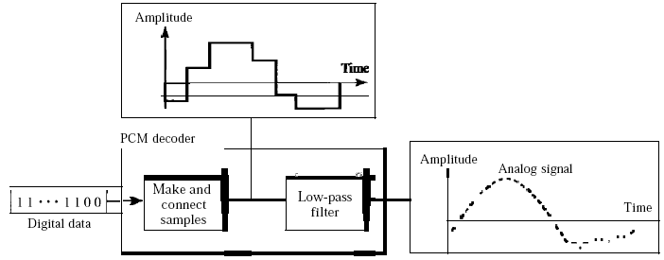
Components of a PCM decoder

Slide 44

PCM Bandwidth
This means the minimum bandwidth of the digital signal is nb times greater than the bandwidth of the analog signal.
This is the price we pay for digitization.

Slide 45
Delta Modulation (DM)
PCM is a very complex technique.
Other techniques have been developed to reduce the complexity of PCM.
The simplest is delta modulation.
PCM finds the value of the signal amplitude for each sample;
DM finds the change from the previous sample.
Note that there are no code words here; bits are sent one after another.

Slide 46
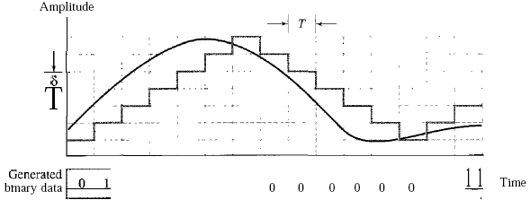
The process of delta modulation

Slide 47
Modulator
The modulator is used at the sender site to create a stream of bits from an analog signal.
The process records the small positive or negative changes, called delta ɣ.
If the delta is positive, the process records a 1; if it is negative, the process records a 0.
However, the process needs a base against which the analog signal is compared.
The modulator builds a second signal that resembles a staircase.
Finding the change is then reduced to comparing the input signal with the gradually made staircase signal.

Slide 48
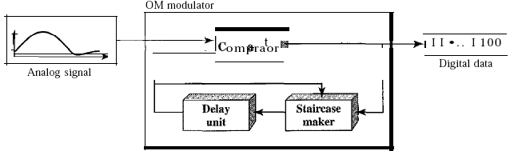
Delta modulation components

Slide 49
Modulator
The modulator, at each sampling interval, compares the value of the analog signal with the last value of the staircase signal.
If the amplitude of the analog signal is larger, the next bit in the digital data is 1; otherwise, it is 0.
The output of the comparator, however, also makes the staircase itself. If the next bit is 1, the staircase maker moves the last point of the staircase signal ɣ up; if the next bit is 0, it moves it ɣ down.
Note that we need a delay unit to hold the staircase function for a period between two comparisons.

Slide 50
Demodulator
The demodulator takes the digital data and, using the staircase maker and the delay unit, creates the analog signal.
The created analog signal, however, needs to pass through a low-pass filter for smoothing.

Slide 51
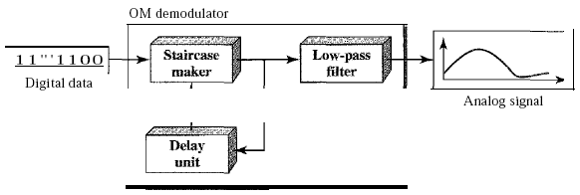
Delta demodulation components

Slide 52
Adaptive DM
  A better performance can be achieved if the value of 0 is not fixed.
  In adaptive delta modulation, the value of 0 changes according to the amplitude of the analog signal.
Quantization Error
  It is obvious that DM is not perfect.
  Quantization error is always introduced in the process.
  The quantization error of DM, however, is much less than that for PCM.

Slide 53
ANALOG-TO-ANALOG CONVERSION
Analog-to-analog conversion, or analog modulation, is the representation of analog information by an analog signal.
One may ask why we need to modulate an analog signal; it is already analog.
Modulation is needed if the medium is bandpass in nature or if only a bandpass channel is available to us.
An example is radio. The government assigns a narrow bandwidth to each radio station.
The analog signal produced by each station is a low-pass signal, all in the same range.
To be able to listen to different stations, the low-pass signals need to be shifted, each to a different range.

Slide 54
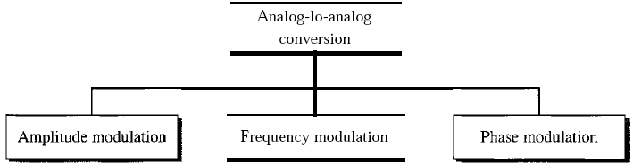
Types of analog-to-analog modulation

Slide 55
Amplitude Modulation
In AM transmission, the carrier signal is modulated so that its amplitude varies with the changing amplitudes of the modulating signal.
The frequency and phase of the carrier remain the same; only the amplitude changes to follow variations in the information.
The modulating signal is the envelope of the carrier.

Slide 56
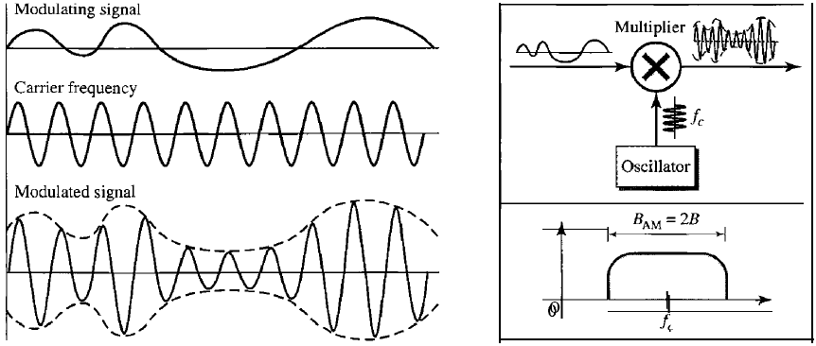
Amplitude modulation

Slide 57
AM is normally implemented by using a simple multiplier because the amplitude of the carrier signal needs to be changed according to the amplitude of the modulating signal.
AM Bandwidth
  The modulation creates a bandwidth that is twice the bandwidth of the modulating signal and covers a range centered on the carrier frequency. However, the signal components above and below the carrier frequency carry exactly the same information.
  The total bandwidth required for AM can be determined from the bandwidth of the audio signal: BAM =2B.

Slide 58
Standard Bandwidth Allocation for AM(Radio)
The bandwidth of an audio signal (speech and music) is usually 5 kHz.
Therefore, an AM radio station needs a bandwidth of 10kHz. In fact, the Federal Communications Commission (FCC) allows 10 kHz for each AM station.
AM stations are allowed carrier frequencies anywhere between 530 and 1700 kHz (1.7 MHz).
However, each station's carrier frequency must be separated from those on either side of it by at least 10 kHz (one AM bandwidth) to avoid interference.
If one station uses a carrier frequency of 1100 kHz, the next station's carrier frequency cannot be lower than 1110 kHz

Slide 59
Frequency Modulation
In FM transmission, the frequency of the carrier signal is modulated to follow the changing voltage level (amplitude) of the modulating signal.
The peak amplitude and phase of the carrier signal remain constant, but as the amplitude of the information signal changes, the frequency of the carrier changes correspondingly
FM is normally implemented by using a voltage-controlled oscillator as with FSK.
The frequency of the oscillator changes according to the input voltage which is the amplitude of the modulating signal.

Slide 60
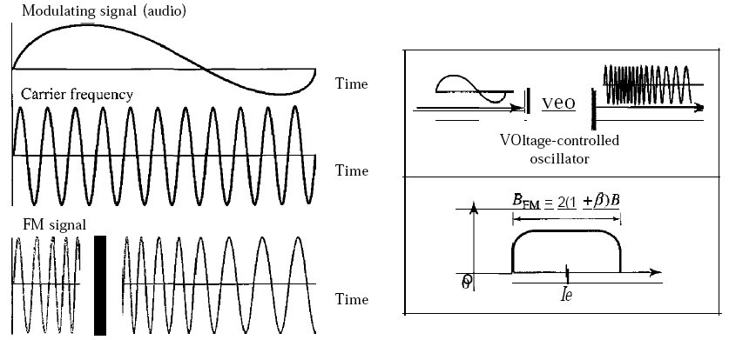
Frequency modulation

Slide 61
Standard Bandwidth allocation for FM Radio
The bandwidth of an audio signal (speech and music) broadcast in stereo is almost 15 kHz.
The FCC allows 200 kHz (0.2 MHz) for each station. This mean ᵝ = 4 with some extra guard band.
FM stations are allowed carrier frequencies anywhere between 88 and 108 MHz.
Stations must be separated by at least 200 kHz to keep their bandwidths from overlapping.
To create even more privacy, the FCC requires that in a given area, only alternate bandwidth allocations may be used.
The others remain unused to prevent any possibility of two stations interfering with each other.
Given 88 to 108 MHz as a range, there are 100 potential PM bandwidths in an area, of which 50 can operate at anyone time.

Slide 62
Phase Modulation
In PM transmission, the phase of the carrier signal is modulated to follow the changing voltage level (amplitude) of the modulating signal.
The peak amplitude and frequency of the carrier signal remain constant, but as the amplitude of the information signal changes, the phase of the carrier changes correspondingly.
It can proved mathematically that PM is the same as FM with one difference.
In FM, the instantaneous change in the carrier frequency is proportional to the amplitude of the modulating signal; in PM the instantaneous change in the carrier frequency is proportional to the derivative of the amplitude of the modulating signal.

Slide 63
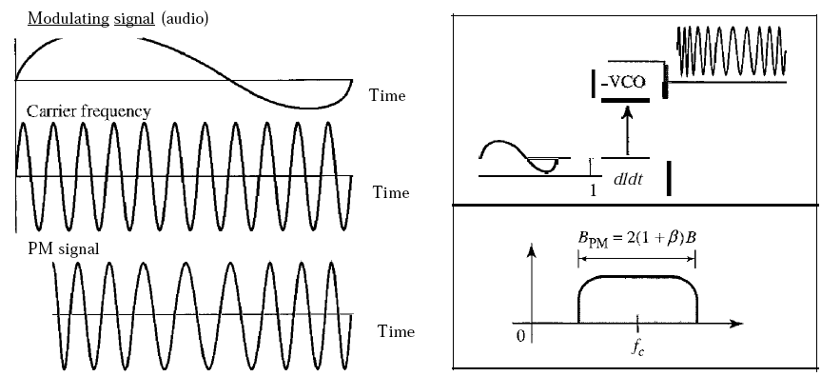
Phase modulation

Slide 64
PM is normally implemented by using a voltage-controlled oscillator along with a derivative.
The frequency of the oscillator changes according to the derivative of the input voltage which is the amplitude of the modulating signal.
PM Bandwidth
  The actual bandwidth is difficult to determine exactly, but it can be shown empirically that it is several times that of the analog signal.
  Although, the formula shows the same bandwidth for FM and PM, the value of ᵝ is lower in the case of PM
The total bandwidth required for PM can be determined from the bandwidth and maximum amplitude of the modulating signal:
BpM = 2(1 + ᵝ )B.

